Slide 1
UNEPI Dashboard Project Spec

Slide 2
Cold Chain Management Metrics/Tabs - Immunizing Facilities (Mapping completed) - Functionality (Mapping completed) - Capacity (Mapping completed) - Temperature Alarms (WIP)

Slide 3
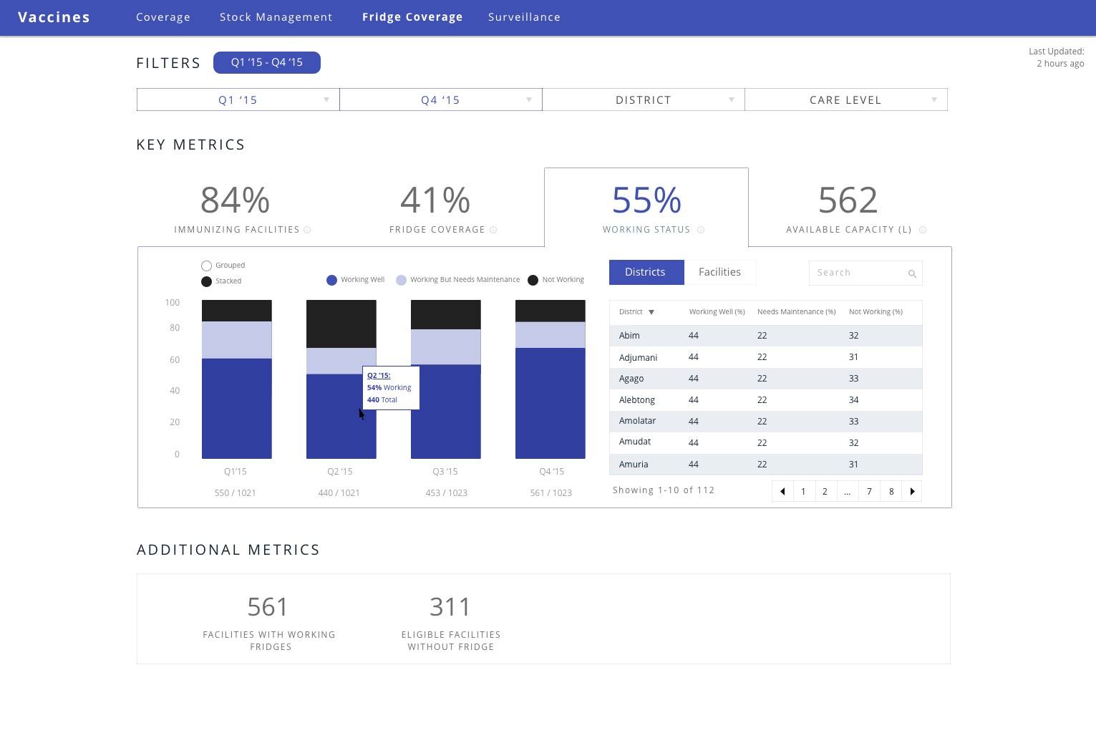
Cold chain
Show on the same tab as “Immunizing Facilities”. The 4th tab should then be “Temperature monitoring. Data yet to be defined
Label as “CCE Coverage”
Change to “Functionality”
Return an absolute number not a %
Values in the table should be absolute numbers; for the 3 columns
Remove words. Only leave Q1-Q4
Question - when the year changes, does Q1’16 change to Q1’17?
Remove word
Remove both metrics

Slide 4
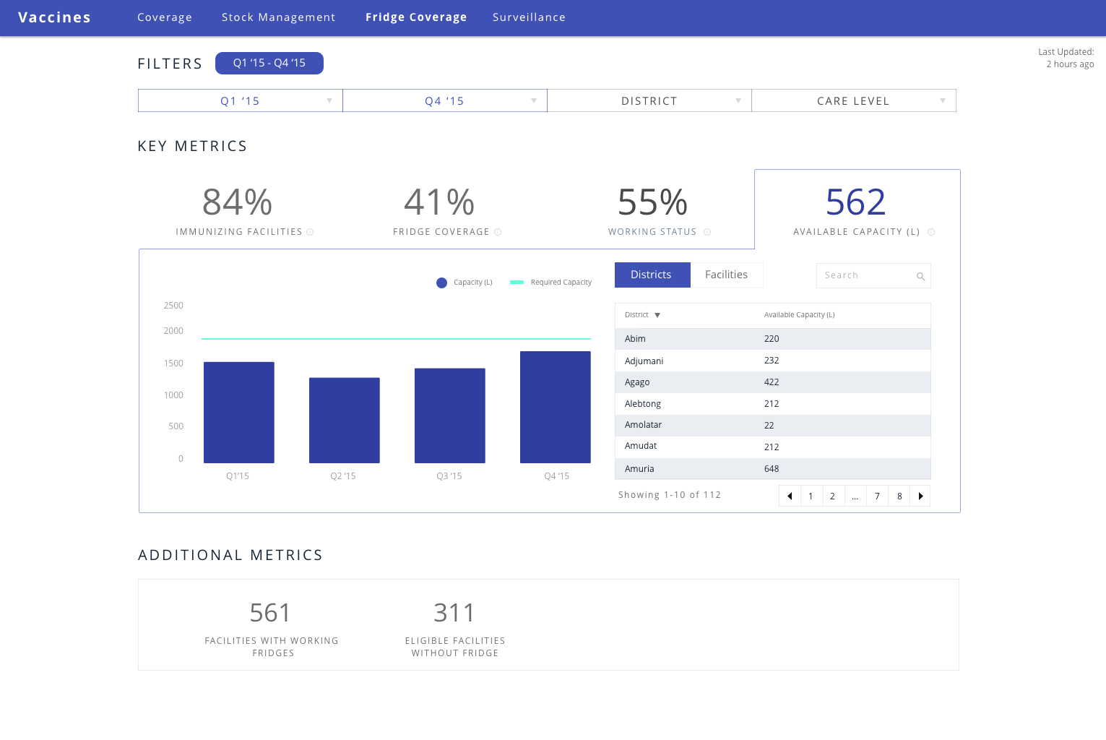
Label as “Capacity” and change L to “Litres”
Make the table similar to that of working status with 4 columns; District, Required, Available, Gap.
Values shown should be in litres
Rename word to “ Sites with sufficient (*) capacity”. Add an asterisk at the bottom that describes sufficient capacity as follows “(*) Sufficient refers to no capacity gap”
Remove all metrics and replace them with 3 metrics;
“% with sufficient capacity, % with surplus capacity and % with a shortage

Slide 5
Clarifications
Default filter is last 4 quarters
Key metric (the 4 big numbers on top) shows the metric for the most recent month (so if you filter from Aug – Oct, it will show Oct). The date filter affects the graph because Aug – Oct will be shown on the x-axis.
Data will be updated on a quarterly basis
Fridge capacity charts should be simple bar graphs with line for required amount (provided yearly, doesn’t show if not provided)
Have attached the relevant mapping.

Slide 6
Mapping

